Slide 1
CSE 260
DIGITAL LOGIC DESIGN
Sequential Logic, RS Flip-Flop,
D Flip-Flop, JK Flip-Flop, T Flip-Flop
BRAC University

Slide 2
Introduction
A sequential circuit consists of a feedback path, and employs some memory elements.
Combinational outputs
Memory outputs
Combinational logic
Memory elements
External inputs
Sequential circuit = Combinational logic + Memory Elements
output= external input + present state of memory element

Slide 3
Introduction
There are two types of sequential circuits:
  synchronous: outputs change only at specific time (i.e. with clock input)
  asynchronous: outputs change at any time (i.e. without clock input)
Multivibrator: a class of sequential circuits. They can be:
  bistable (2 stable states)
  monostable or one-shot (1 stable state)
  astable (no stable state)
Bistable logic devices: flip-flops.
Flip-flops differ in the method used for changing their state.

Slide 4
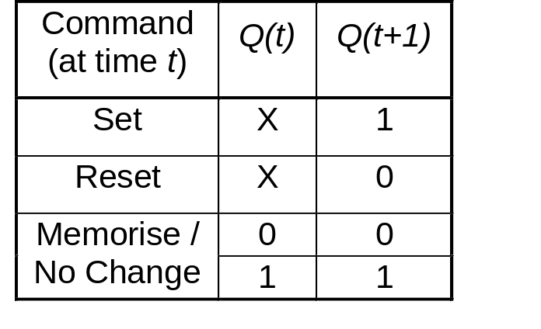
Memory Elements
Memory element: a device which can remember value indefinitely, or change value on command from its inputs.
Characteristic table:
Memory element
Q
command
stored value
Q(t): current state
Q(t+1) or Q⁺: next state

Slide 5
Memory Elements
Memory element with clock. Flip-flops are memory elements that change state on clock signals.
Clock is usually a square wave.
Memory element
Q
command
stored value
clock
Positive pulses
Positive edges
Negative edges

Slide 6
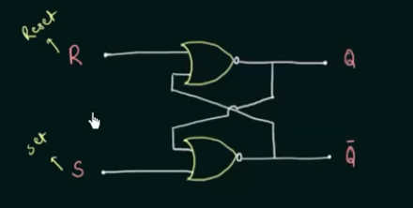
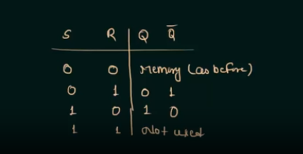
https://www.youtube.com/watch?v=kt8d3CYWGH4

Slide 7
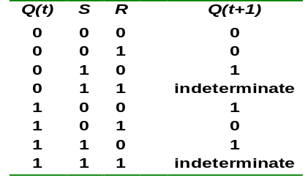
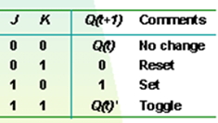
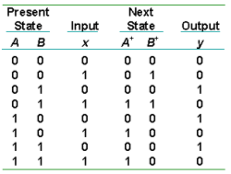
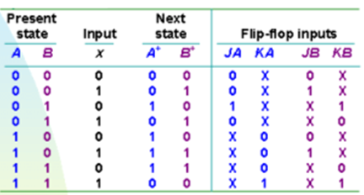
Types of tables in sequential circuit
Characteristic table
Criteria Table
State Table
Excitation table
MOHD. YAMANI IDRIS/ NOORZAILY MOHAMED NOOR

Slide 8
S-R Flip-Flop
Complementary outputs: Q and Q'.
When Q is HIGH, the FF is in SET state.
When Q is LOW, the FF is in RESET state.
For active-HIGH input S-R FF (also known as NOR gate FF),
R=HIGH (and S=LOW)  RESET state
S=HIGH (and R=LOW)  SET state
both inputs LOW  no change
both inputs HIGH  Q and Q' both LOW (invalid)!

Slide 9
S-R FF
For active-LOW input S'-R' FF (also known as NAND gate FF),
R'=LOW (and S'=HIGH)  RESET state
S'=LOW (and R'=HIGH)  SET state
both inputs HIGH  no change
both inputs LOW  Q and Q' both HIGH (invalid)!
Drawback of S-R FF: invalid condition exists and must be avoided.

Slide 10
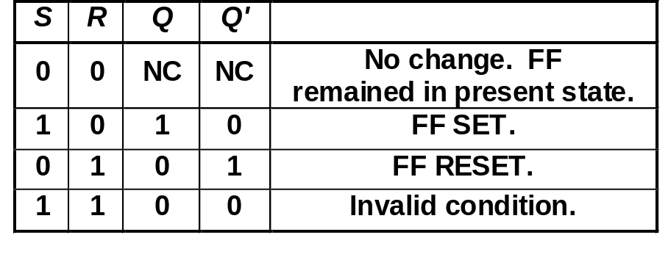
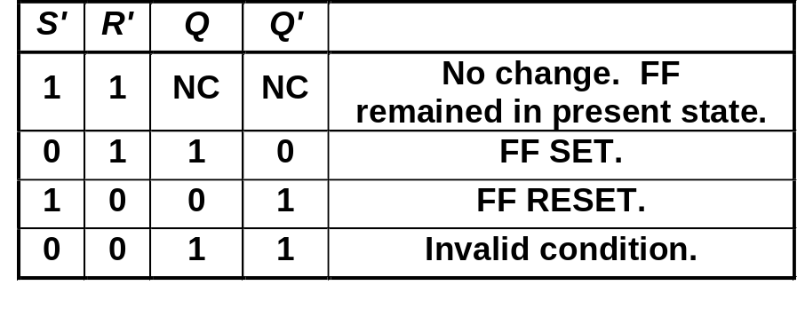
S-R FF
Characteristics table for active-high input S-R FF:
Characteristics table for active-low input S'-R' FF:
Use this mostly
S
R
Q
Q'
S
R
Q
Q'
Notice the difference

Slide 11
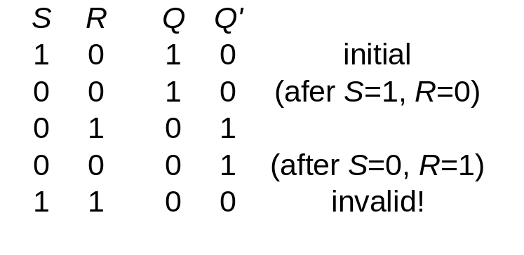
S-R FF: Active-HIGH input S-R FF
1
0
1
0
0
R
1
1
0
0
Q
0
Q'
0
0
1
1
1
0
0
0
0
1
S
NOR truth table
A | B | Output
0 | 0 | 1
0 | 1 | 0
1 | 0 | 0
1 | 1 | 0
Presence of ‘1’ in input, leads to ‘0’ in output

Slide 12
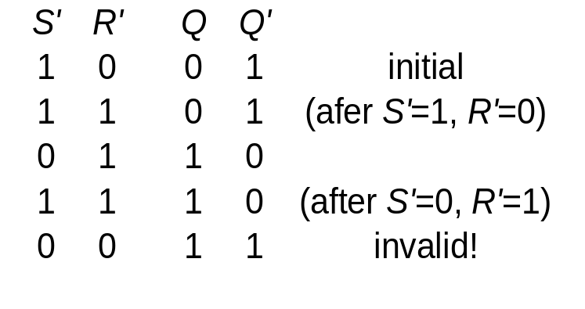
S-R FF: Active-LOW input S’-R’ FF
S'
Q
R'
Q'
S'
Q
R'
Q'
NAND truth table
A | B | Output
0 | 0 | 1
0 | 1 | 1
1 | 0 | 1
1 | 1 | 0
Note: Here output=0 means high!
Presence of ‘0’ in input, leads to ‘1’ in output

Slide 13
S-R FF
R | S | Operation | Q(t) | Q(t+1) | Q’(t) | Q’(t+1)
0 | 0 | No Change | 0 | 0 | 1 | 1
 |  |  | 1 | 1 | 0 | 0
0 | 1 | Set | x | 1 | x | 0
1 | 0 | Reset | x | 0 | x | 1
1 | 1 | Invalid | - | - | - | -
S
R
Q
Q'

Slide 14
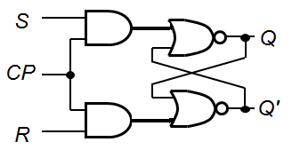
Clocked S-R FF
S-R FF + Clock Pulse (CP) and 2 NAND gates → Clocked S-R FF.
S
CP
R
Q
Q'

Slide 15
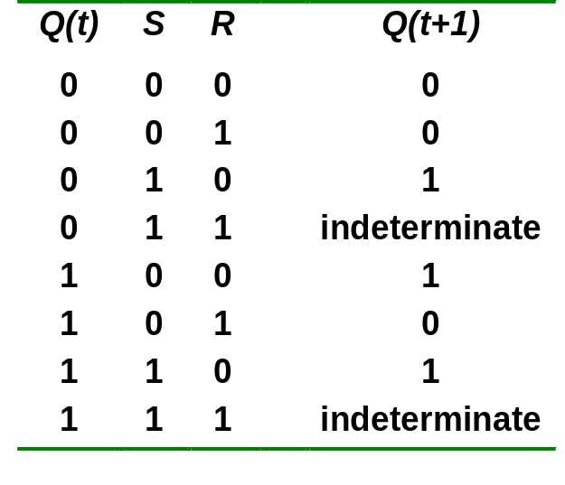
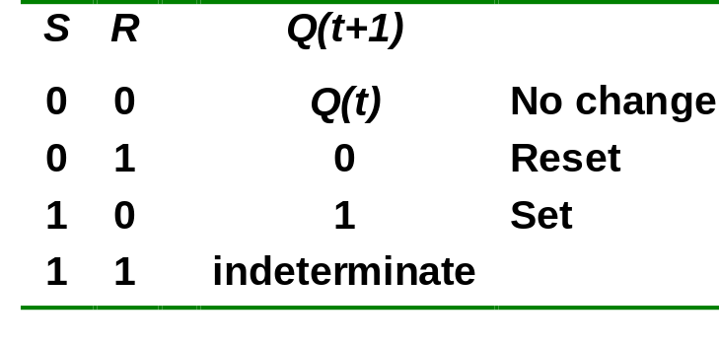
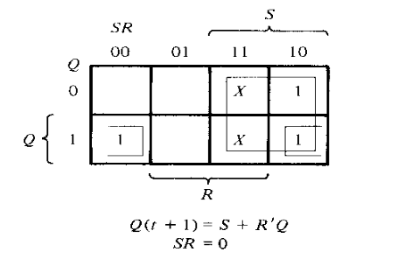
Clocked S-R FF
Outputs change (if necessary) only when CP is HIGH.
Under what condition does the invalid state occur?
Characteristic table: Characteristic Eq^{n}:
CP=1
Q(t+1) = S + R'.Q
S.R = 0

Slide 16
Clocked D Flip-Flop
Make R input equal to S' → D FF.
D FF eliminates the undesirable condition of invalid state in the S-R FF.
D
D
CLK
Q
Q
Q'
CLK
Q'

Slide 17
D Flip-flop Characteristic table
Q(t) | D | Q(t+1)
0 | 0 | 0
0 | 1 | 1
1 | 0 | 0
1 | 1 | 1
Clock
Q

Slide 18
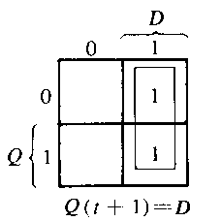
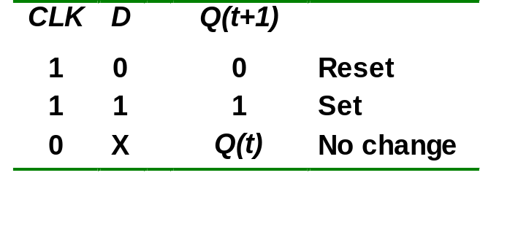
Clocked D Flip-Flop
When CLK is HIGH,
  D=HIGH → FF is SET
  D=LOW → FF is RESET
Hence when CLK is HIGH, Q ‘follows’ the D (data) input.
Characteristic table:
When CLK=1, Q(t+1) = D

Slide 19
D Flip-flop
Application: Parallel data transfer.
To transfer logic-circuit outputs X, Y, Z to flip-flops Q₁, Q₂ and Q₃ for storage.
D
CLK
Q
Q'
Q1 = X
X
Combinational logic circuit
Y
D
CLK
Q
Q'
Q2 = Y
Z
D
CLK
Q
Q'
Q3 = Z
Transfer

Slide 20
Try it yourself
Design a D FF using RS FF
D
Q
CLK
Q'

Slide 21
J-K Flip-flop
J-K flip-flop: Q and Q' are fed back to the NAND gates.
No invalid state.
Include a toggle state.
  J=HIGH (and K=LOW)  SET state
  K=HIGH (and J=LOW)  RESET state
  both inputs LOW  no change
  both inputs HIGH  toggle

Slide 22
J-K FF
SET
RESET
Clock | J | K | Operation | Q(t) | Q(t+1) | Q’(t) | Q’(t+1)
 | 0 | 0 | No Change | 0 | 0 | 1 | 1
 |  |  |  | 1 | 1 | 0 | 0
 | 1 | 0 | Set | x | 1 | x | 0
 | 0 | 1 | Reset | x | 0 | x | 1
 | 1 | 1 | Toggle | 1 | 0 | 0 | 1

Slide 23
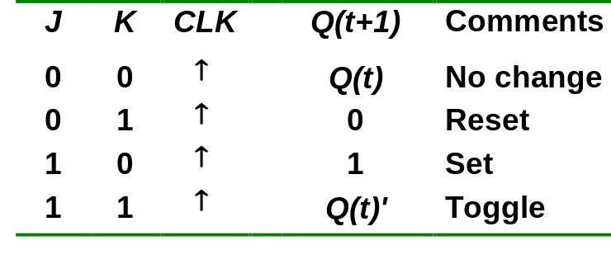
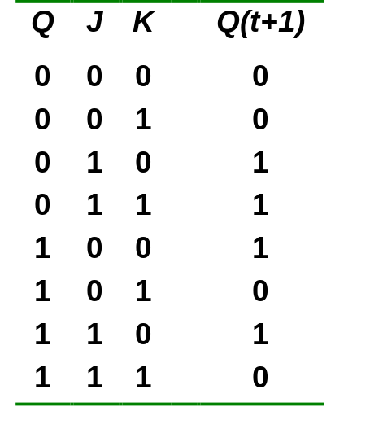
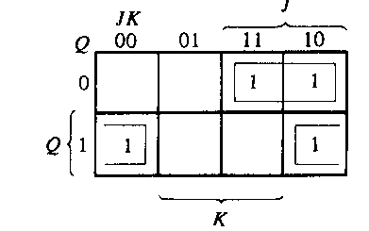
J-K Flip-flop
J-K flip-flop.
Characteristic table.
J
Q
Pulse transition detector
CLK
Q'
K
Q(t+1) = J.Q' + K'.Q

Slide 24
T Flip-flop
T | Operation | Q(t) | Q(t+1)
0 | No change | 0 | 0
 |  | 1 | 1
1 | Toggle | 0 | 1
 |  | 1 | 0
T
J
C
K
Q
Q'
CLK

Slide 25
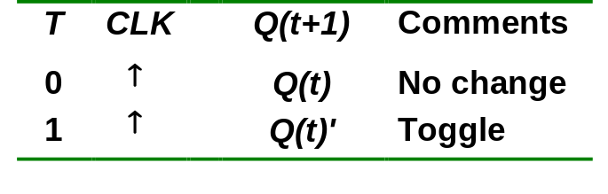
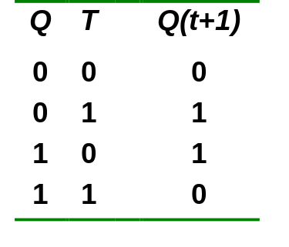
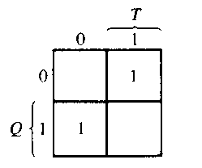
T Flip-flop
T flip-flop: single-input version of the J-K flip flop, formed by tying both inputs together.
Characteristic table.
T
T
J
C
K
Q
Q
Q'
Pulse transition detector
CLK
CLK
Q'
Q(t+1) = T.Q' + T'.Q

Slide 26
T Flip-flop
Application: Frequency division.
Application: Counter
High
High
High
J
C
K
J
C
K
QA
J
C
K
QB
Q
CLK
CLK
CLK
CLK
Q
QA
QB
Divide clock frequency by 2.
Divide clock frequency by 4.

Slide 27
Try it yourself
Design a T FF using JK FF
Design a D FF using JK FF

Slide 28
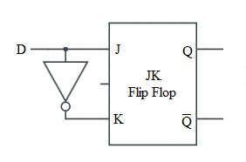
T
J
C
K
Q
Q'
CLK

Slide 29
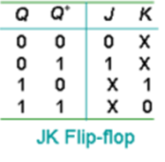
How to build excitation table:
Example: JK Flip-Flop
Q | Q+ | Actually what happens |  | Final Combined Result
 |  | J | K | J | K
0 | 0 | 0 | 1 | 0 | x
 |  | 0 | 0
0 | 1 | 1 | 0 | 1 | x
 |  | 1 | 1
1 | 0 | 0 | 1 | x | 1
 |  | 1 | 1
1 | 1 | 0 | 0 | x | 0
 |  | 1 | 0
MOHD. YAMANI IDRIS/ NOORZAILY MOHAMED NOOR

Slide 30
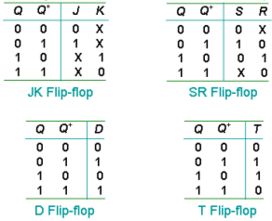
Flip-flop Excitation Tables
Excitation tables : it give transition characteristic between current condition and next condition to determine flip-flop input
MOHD. YAMANI IDRIS/ NOORZAILY MOHAMED NOOR

